Slide 1
BSRO AEM Redesign - Mobile
Creative QA

Slide 2
Mobile

Slide 3
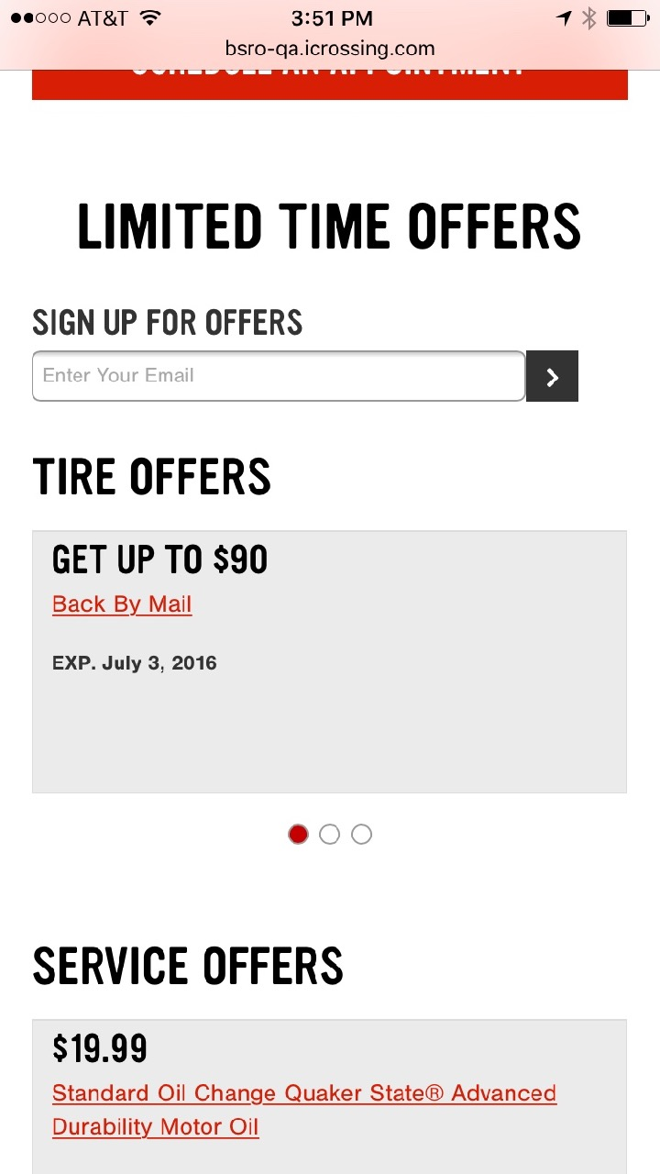
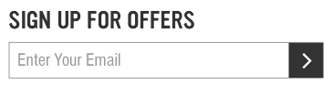
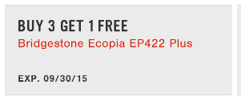
Homepage – Offers Module
Headline should be same size as TIRE OFFERS. Form field is too small and should be a square, not have rounded corners.
Example from comp
Example from comp
Coupon layout is all wrong. Check padding above headline. Size of headline and subhead are too small. Subhead shouldn’t be underlined. And position of the expiration date is too close to subhead. .

Slide 4

Homepage
Gradient too harsh
Too much space/separation here.

Slide 5
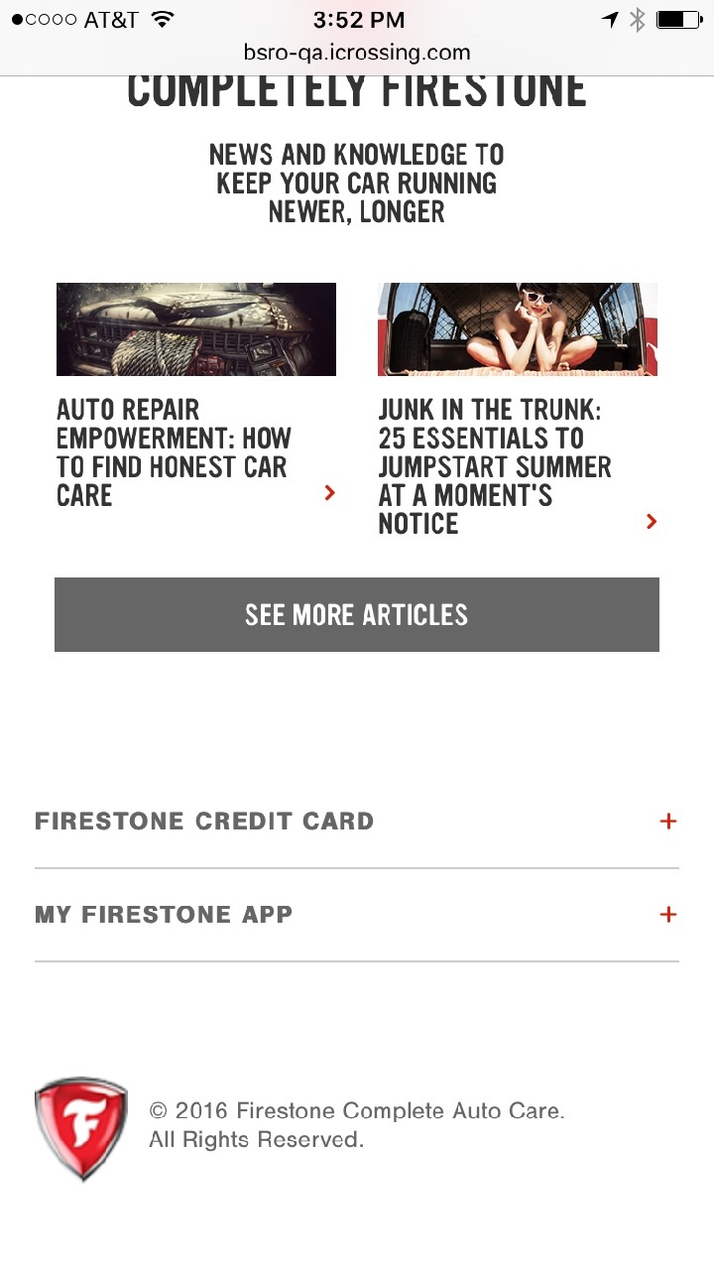
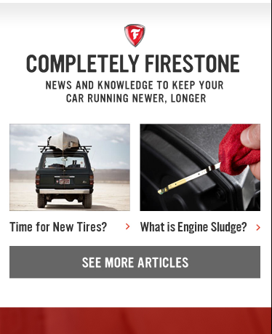
Homepage
Headline should be wider
Example from comp
Too much space/separation here.

Slide 6
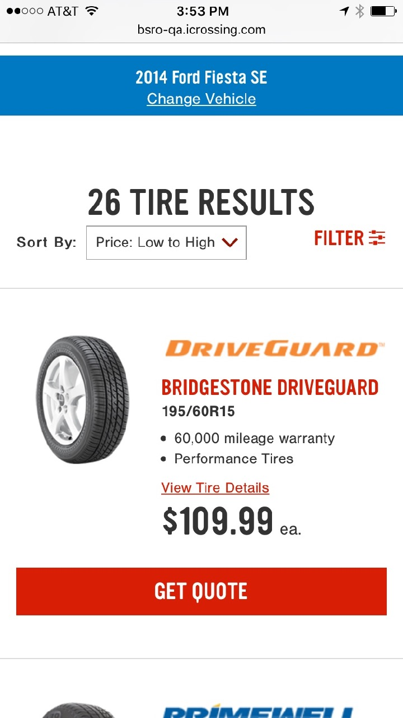
Tire Results
Too much space here. Reduce by 25%.
Too crowded here. Add space between results title and sort.
Filter visual is too high and should be center aligned with the Sort field.
Not sure where all this copy came from. Maybe it should be at the bottom of the page vs at the top.

Slide 7
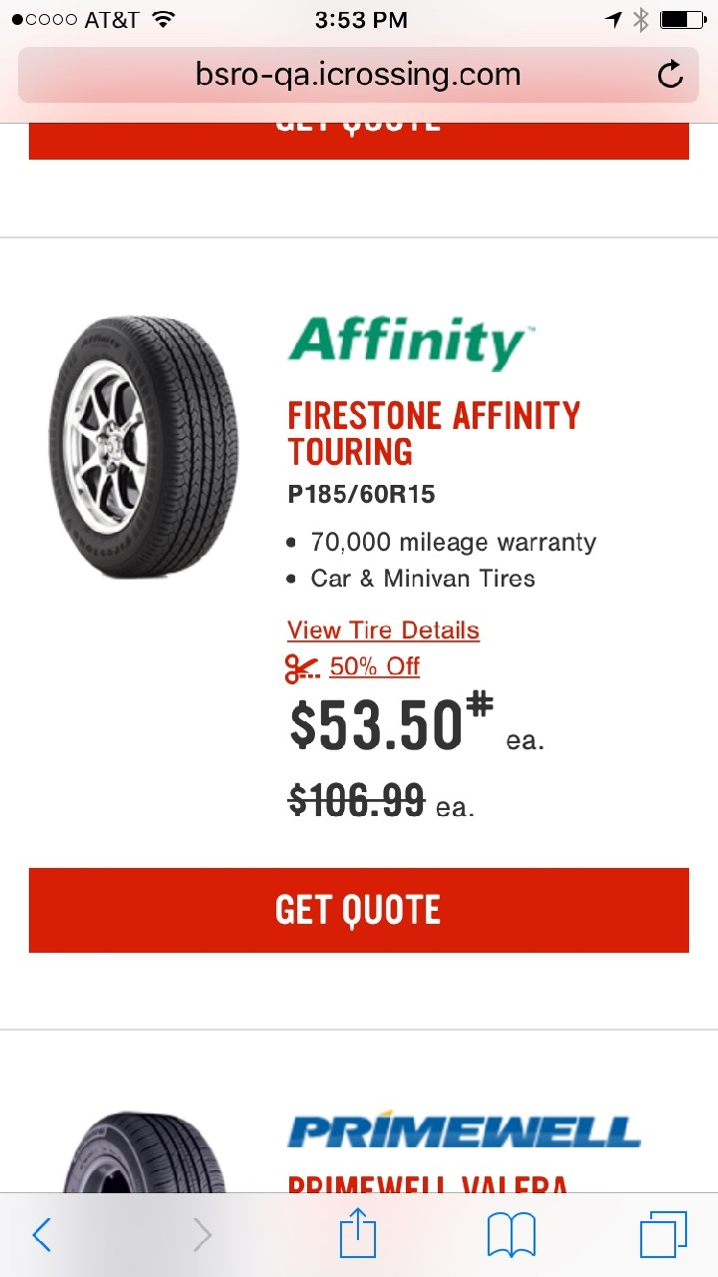
Tire Results cont.
Should this be an asterisk?

Slide 8
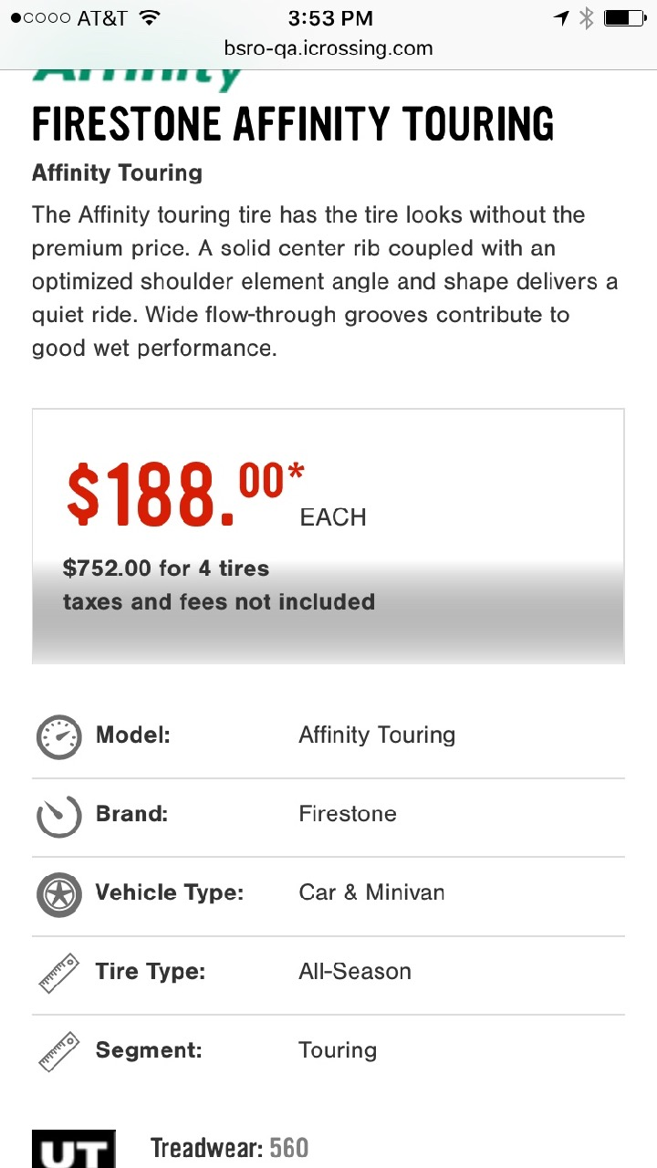
Tire Product Detail
Top Area
Harsh gradient

Slide 9
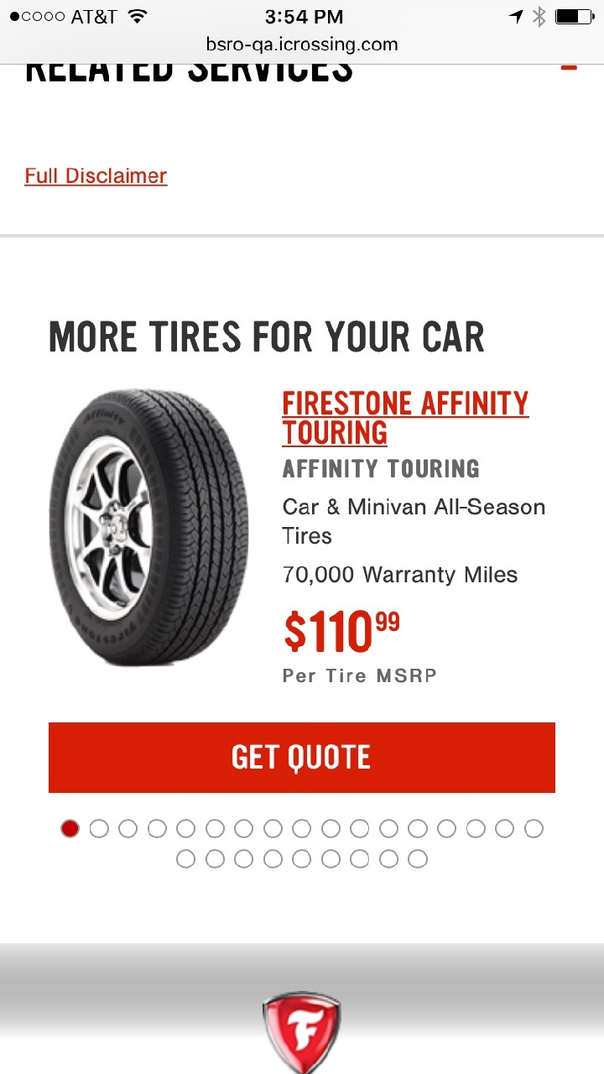
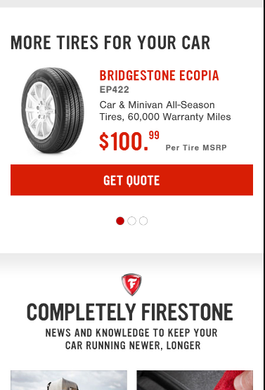
Tire Product Detail cont.
Top Area
Example from comp
Linespacing too crowded. Also, tire name link shouldn’t be underlined.

Slide 10
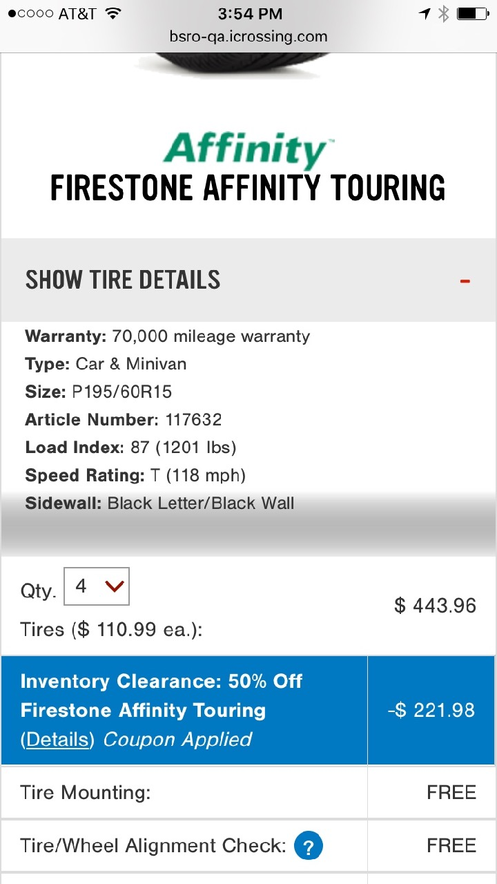
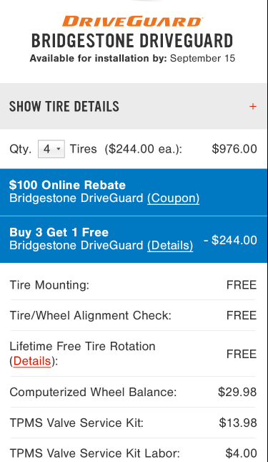
Tire Quote
Top Area
Example from comp
Brand logo too close to name below
Need spacing above. Too close to gray box above
Harsh gradient
Can we move this next to the QTY field like in comp?
This vertical divider line shouldn’t be there

Slide 11
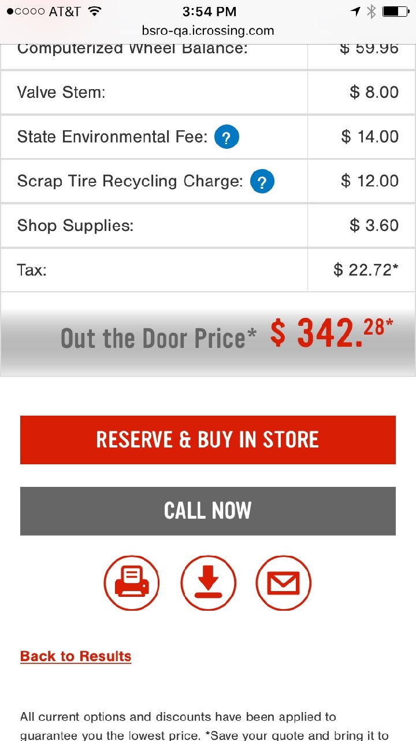
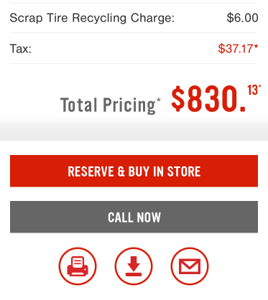
Tire Quote cont.
Example from comp
Harsh gradient. Gradient should start just below the price and not be behind it.

Slide 12
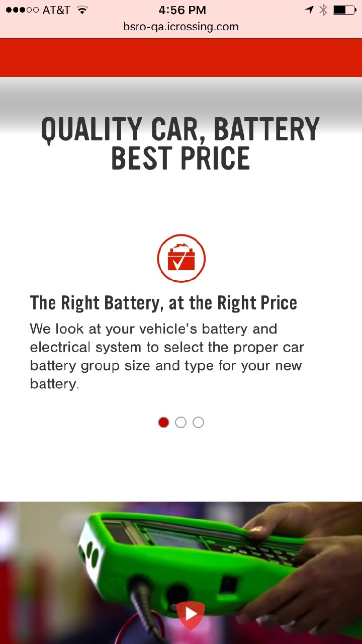
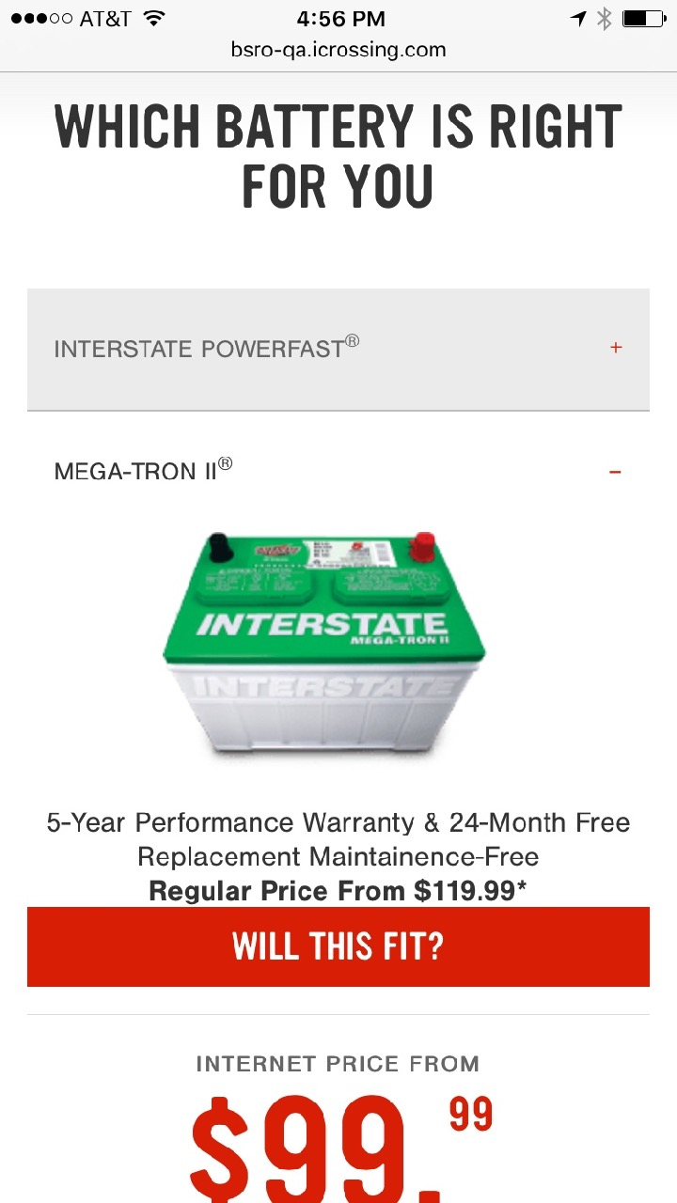
Battery Page
Lower on page
Top Area
Too much space
Center this info if we’re not going to follow the comp.
Way too crowded and image area isn’t tall enough

